Slide 1
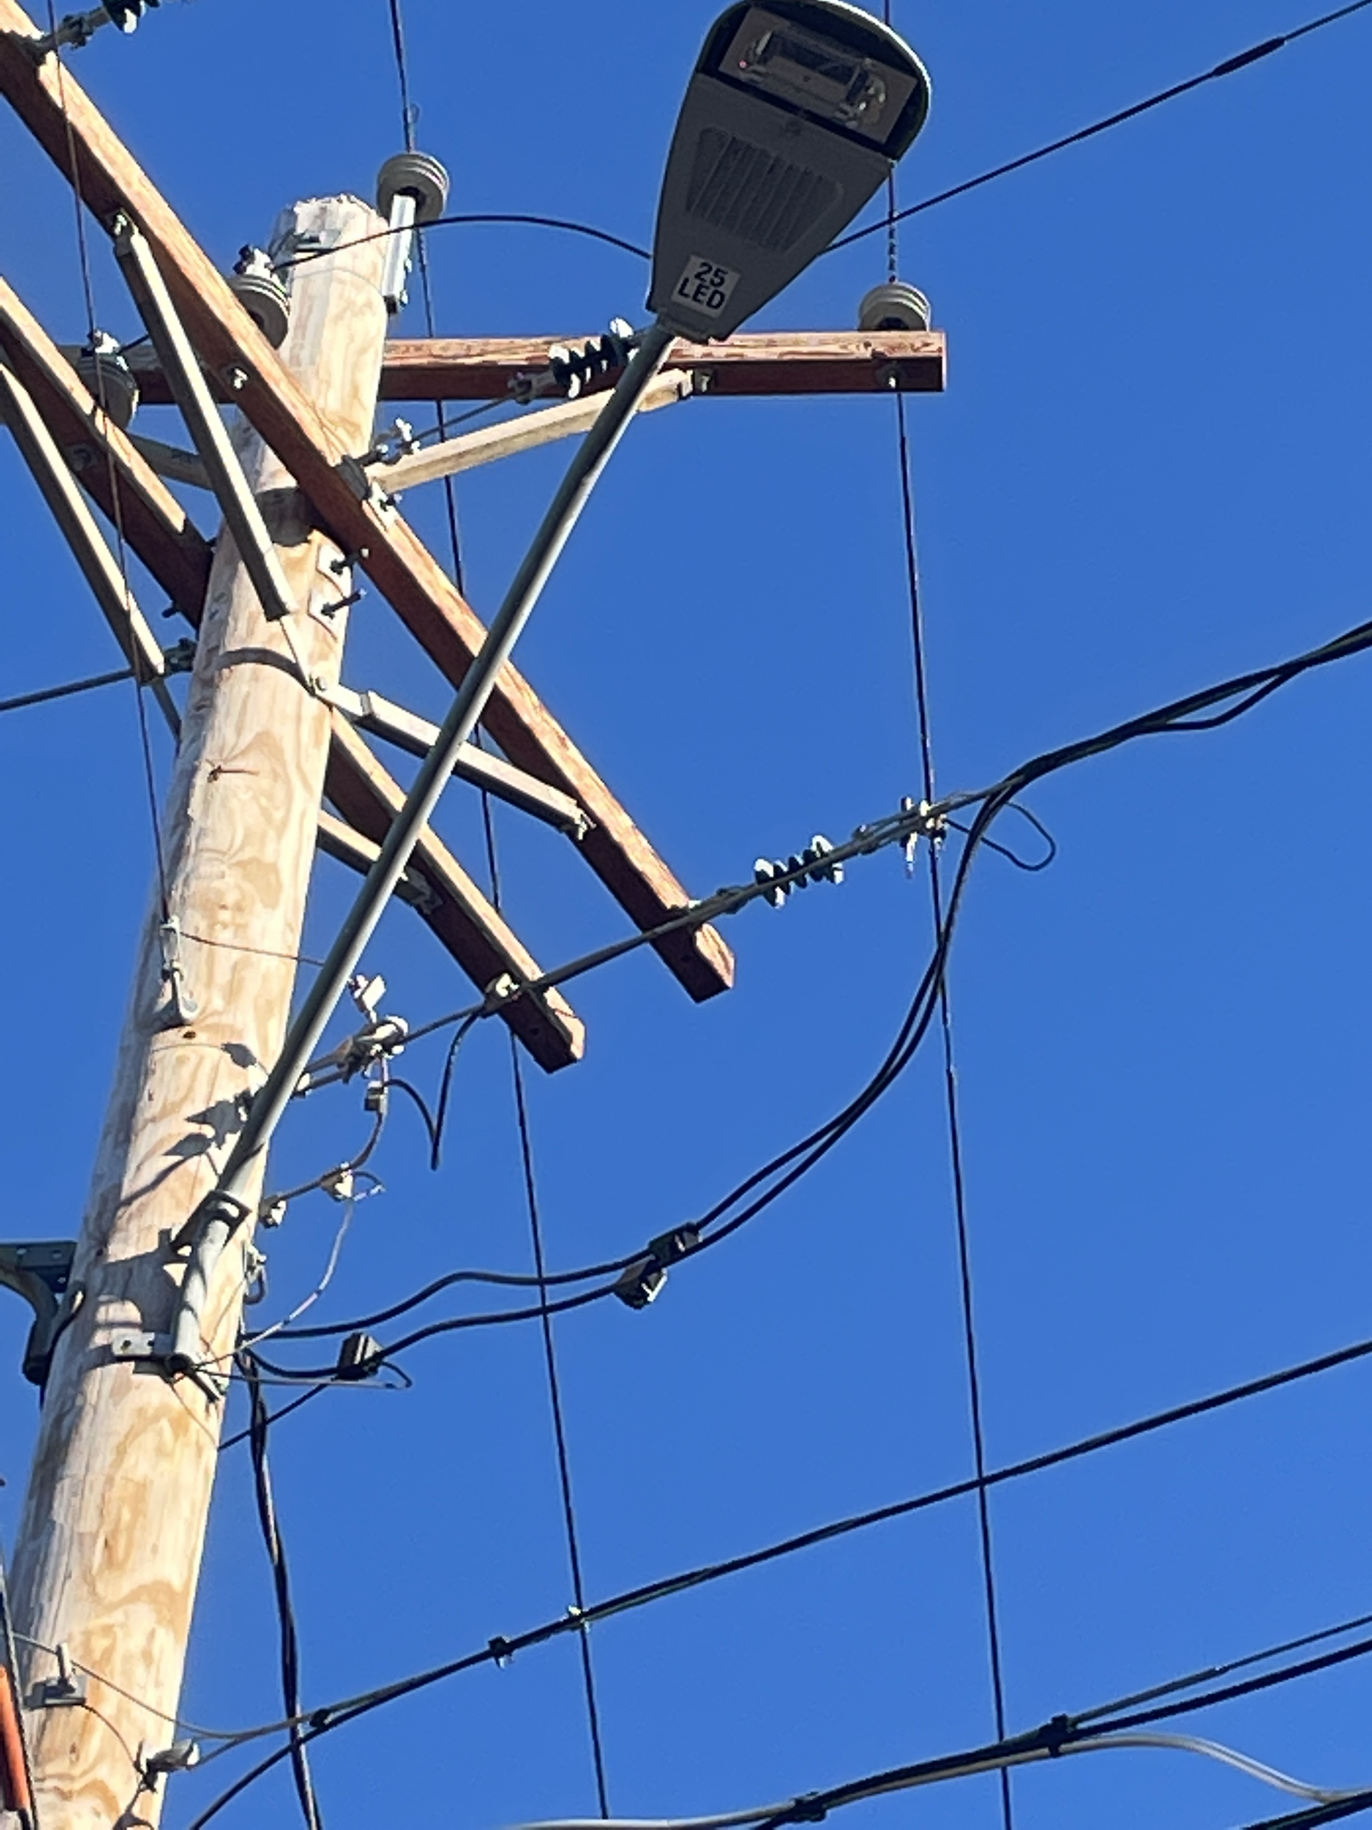
THE GARDINER STREETLAMP ENERGY AUDIT & LED CONVERSION PROJECT

Slide 2
Streetlamp Taskforce
James Brigagliano, Selux Corporation
LC (lighting certified), LEED Green Associate
Tara Hoey, Kim Mayer,
Mark Varian and Stephen Weir
Climate Smart Gardiner

Slide 3

What we have accomplished
Conducted and submitted energy audit to CH
  Documented field inventory with photos
  Created Streetlight Inventory Workbook
Created Streetlight Maps
Developed an outdoor LED lighting policy
  Consulted with dark sky LED outdoor lighting expert
  Created specifications for LED cobraheads
Notes:
“The need for energy efficiency is serious, but so too is minimizing human risk from bad lighting, both due to glare and to circadian disruption. LED technology can optimize both when properly designed.”
(https://www.cnn.com/2016/06/21/health/led-streetlights-ama/index.html

Slide 4
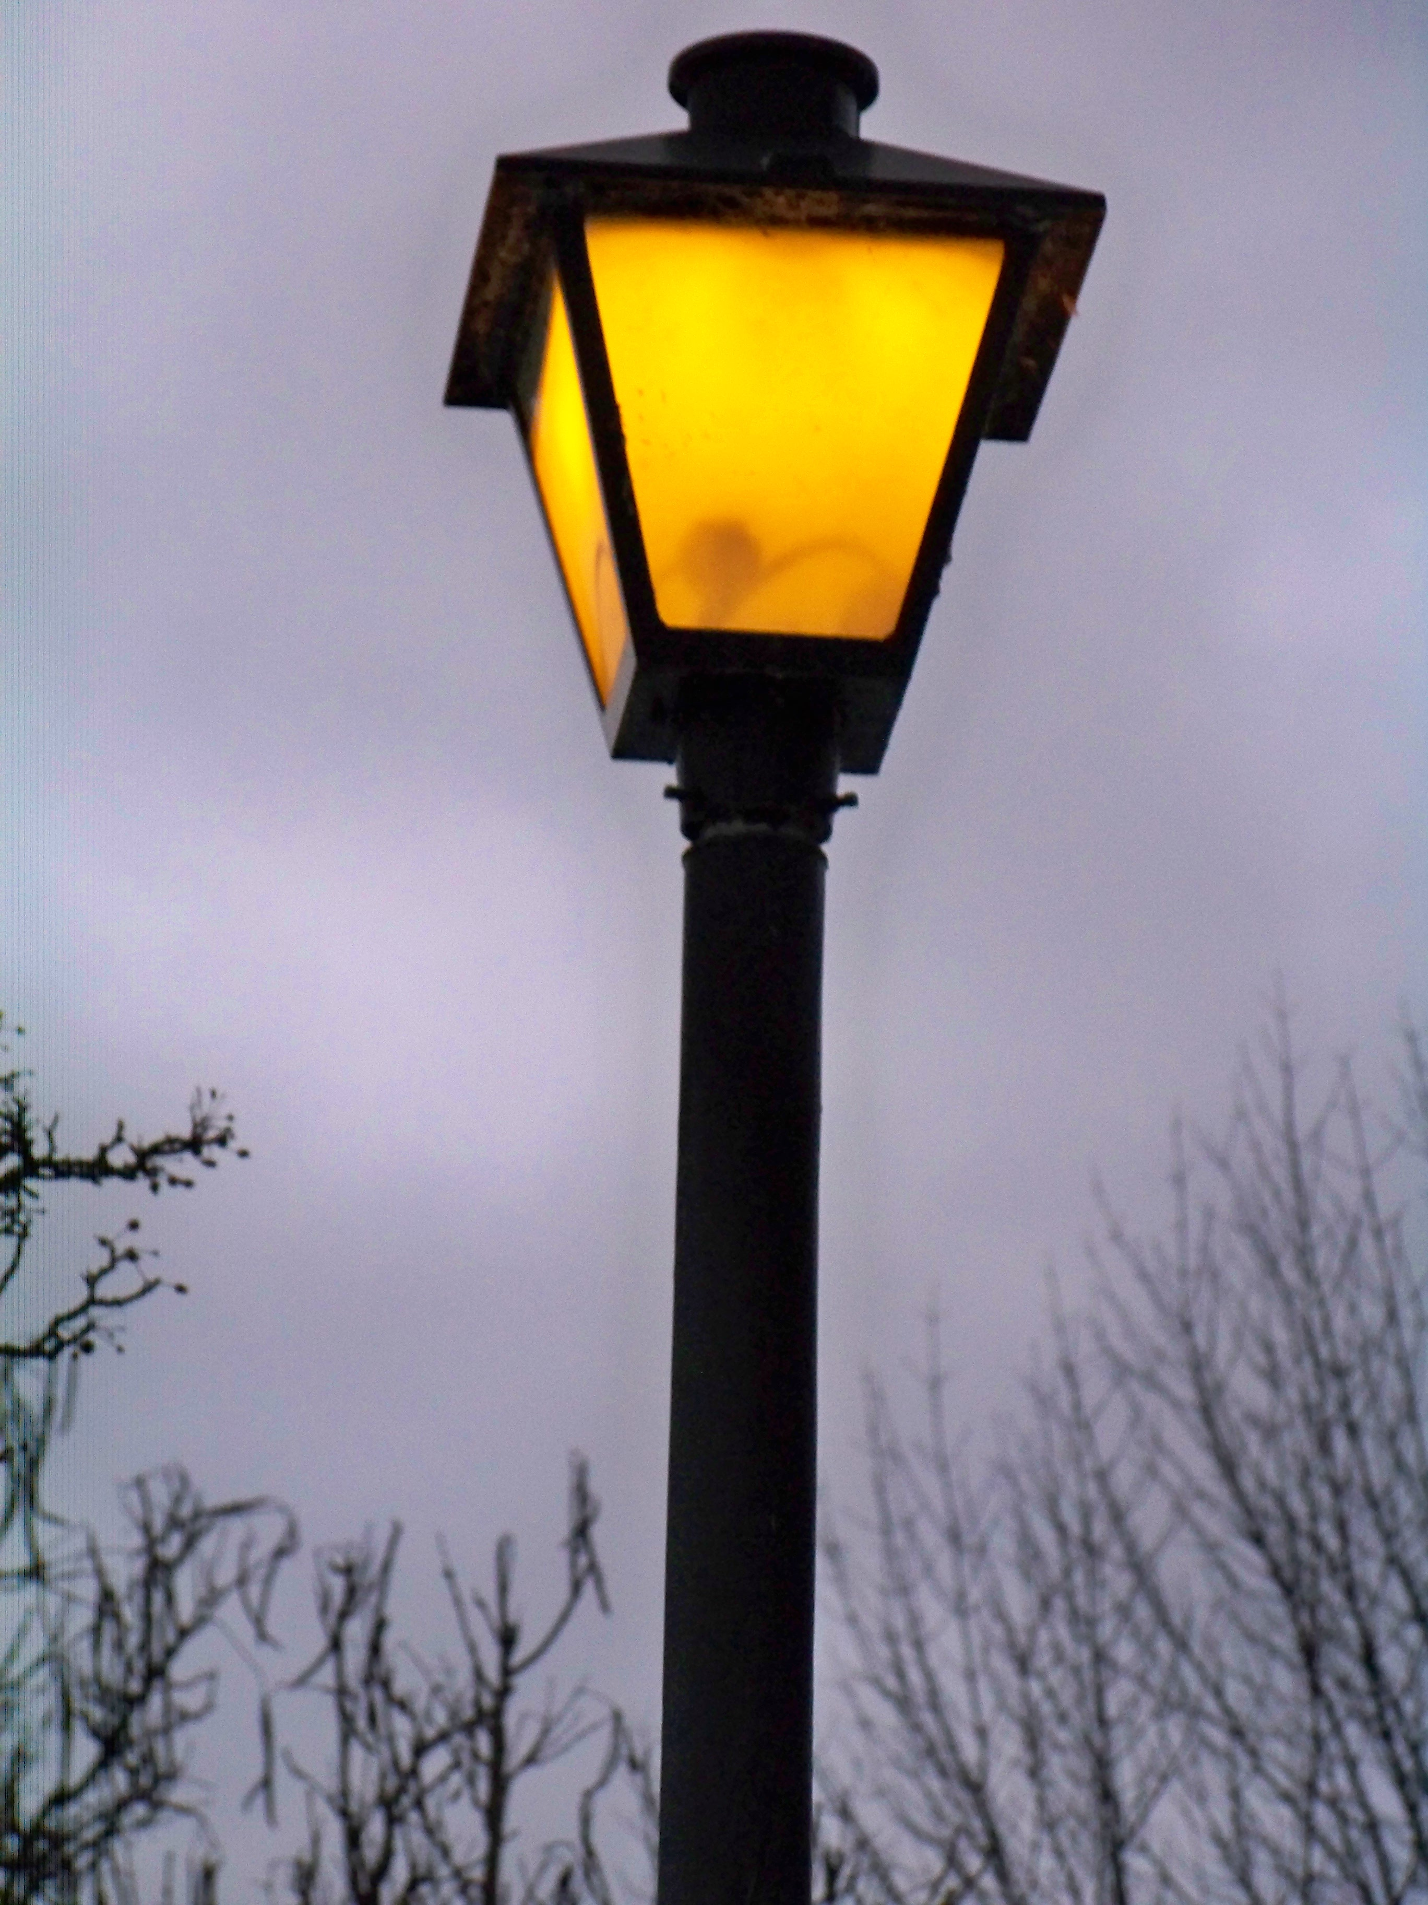
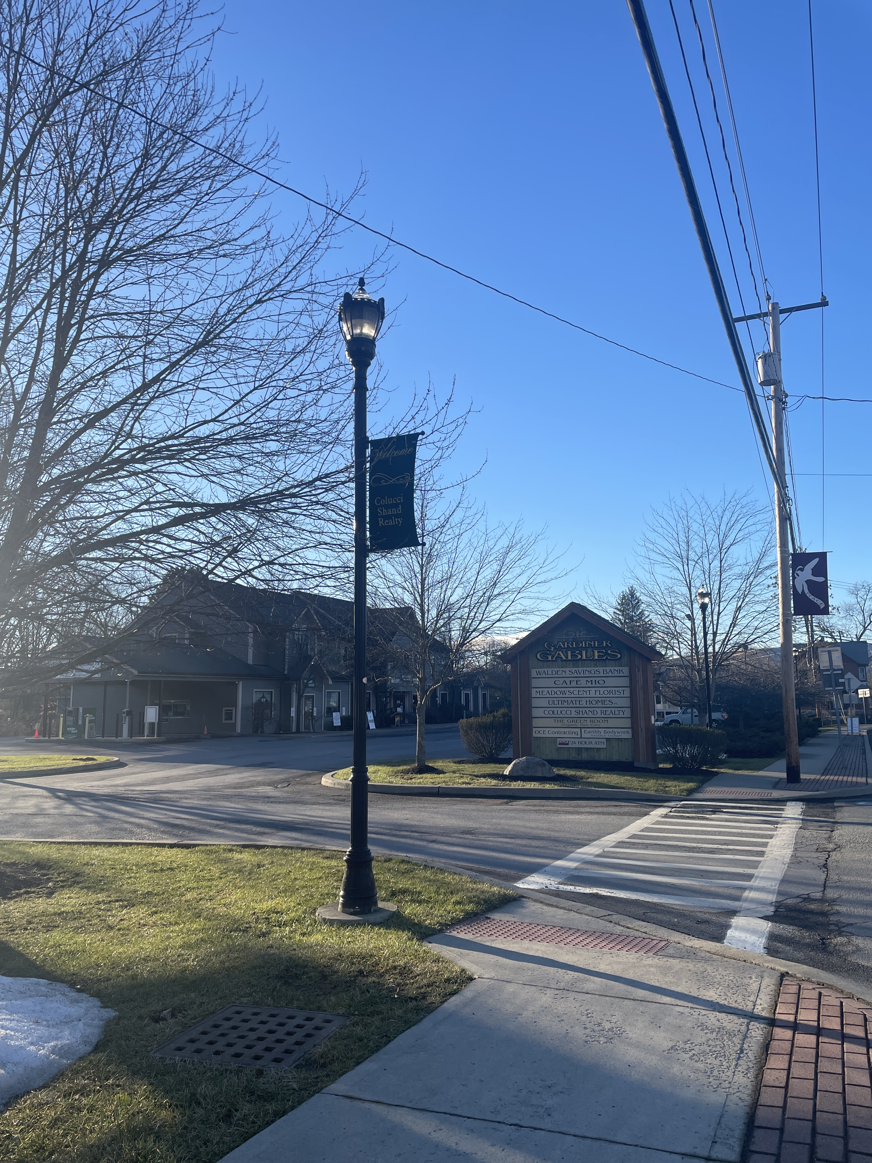
What we have accomplished - Audit
Photographed field inventory – Decoratives
Notes:
“The need for energy efficiency is serious, but so too is minimizing human risk from bad lighting, both due to glare and to circadian disruption. LED technology can optimize both when properly designed.”
(https://www.cnn.com/2016/06/21/health/led-streetlights-ama/index.html

Slide 5
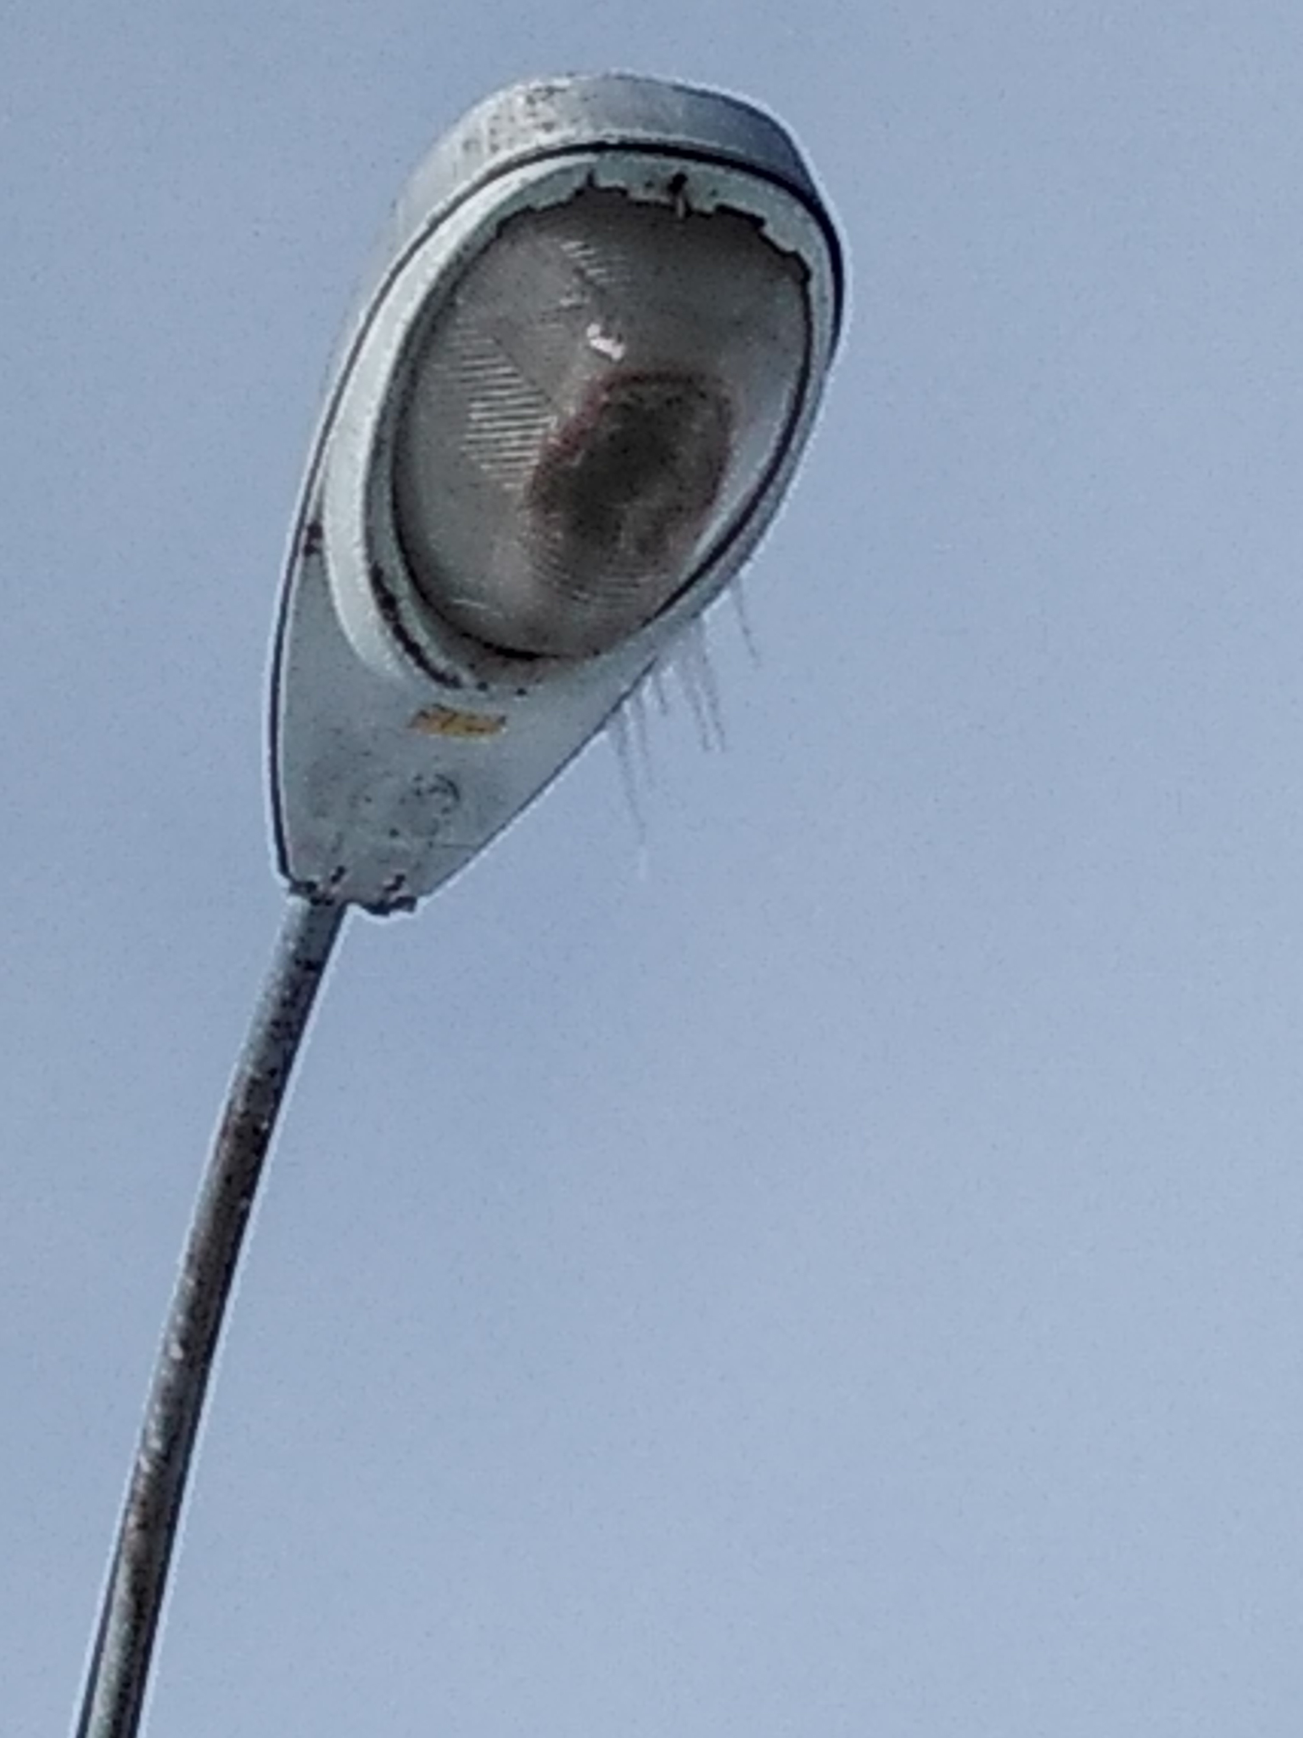
What we have accomplished - Audit
  Photographed CH Cobraheads
Notes:
“The need for energy efficiency is serious, but so too is minimizing human risk from bad lighting, both due to glare and to circadian disruption. LED technology can optimize both when properly designed.”
(https://www.cnn.com/2016/06/21/health/led-streetlights-ama/index.html

Slide 6
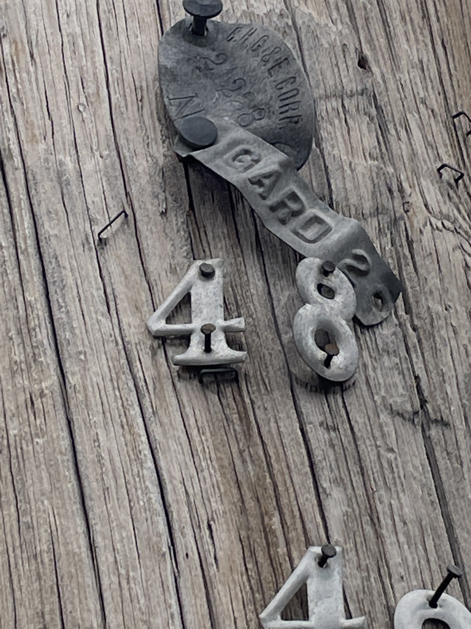
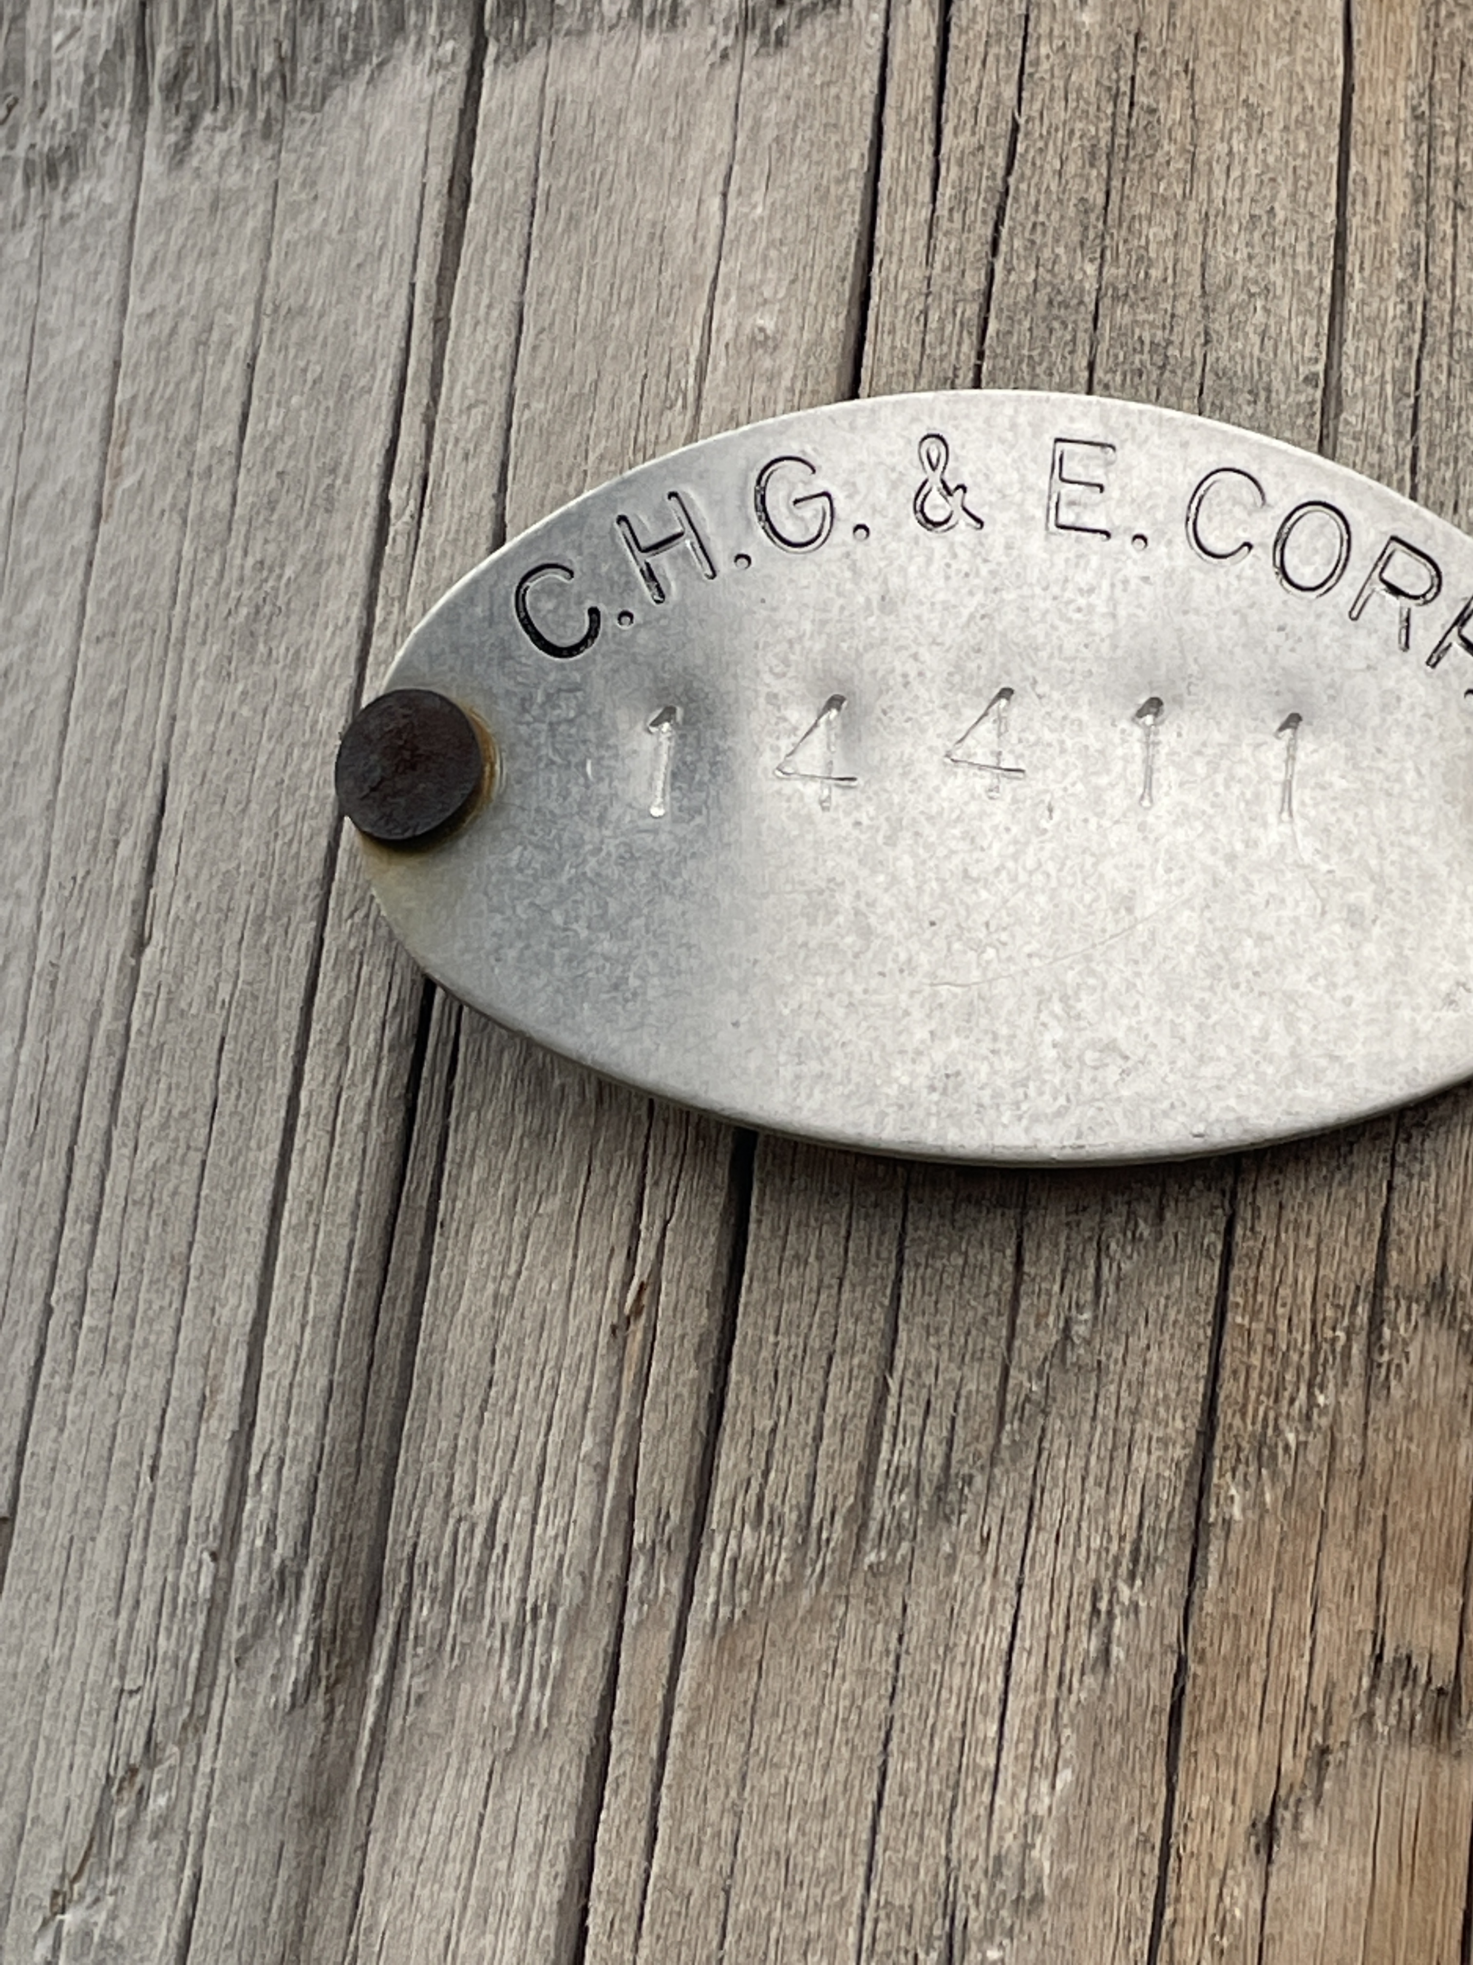
What we have accomplished - Audit
  Photographed Pole Numbers/Tags
Notes:
“The need for energy efficiency is serious, but so too is minimizing human risk from bad lighting, both due to glare and to circadian disruption. LED technology can optimize both when properly designed.”
(https://www.cnn.com/2016/06/21/health/led-streetlights-ama/index.html

Slide 7
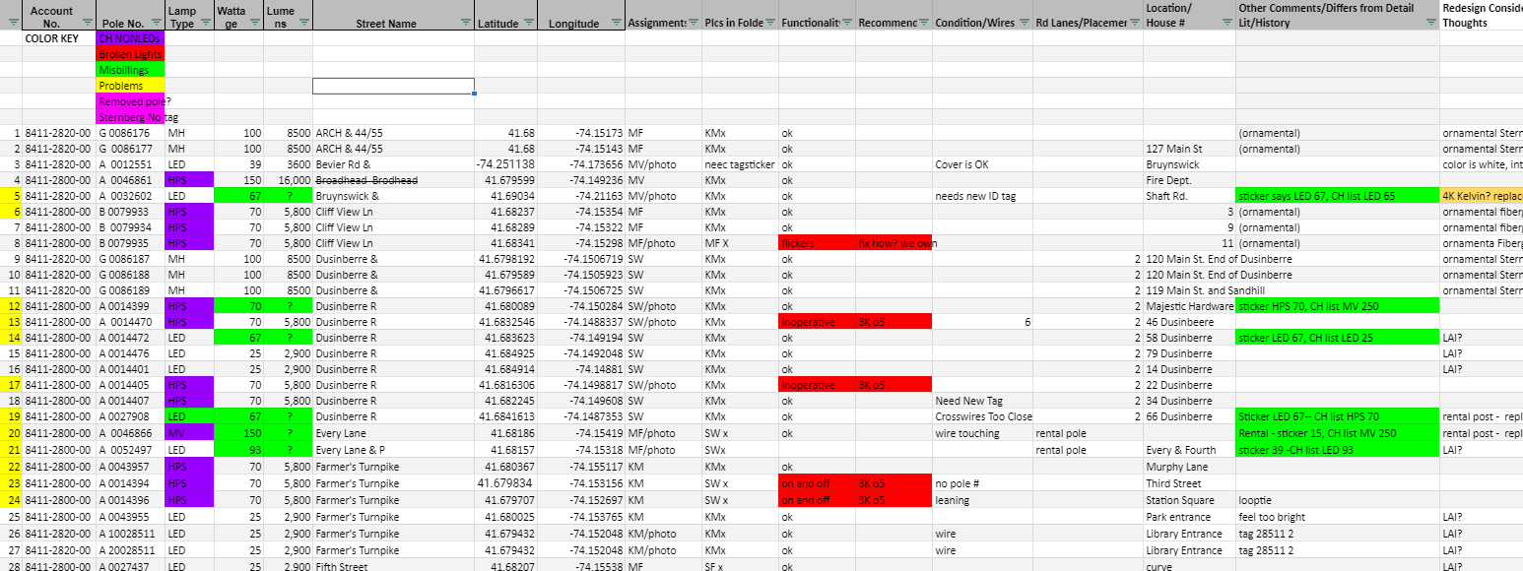
What we have accomplished –
Created Streetlight Inventory Workbook
Notes:
“The need for energy efficiency is serious, but so too is minimizing human risk from bad lighting, both due to glare and to circadian disruption. LED technology can optimize both when properly designed.”
(https://www.cnn.com/2016/06/21/health/led-streetlights-ama/index.html

Slide 8
Streetlight Inventory Workbook -
Billing Findings
18 CH Misbillings – 13 Overbillings
  We expect to receive renumerations due to misbillings
  Billing reimbursement can go as far back as 6 years
  There are 73 not 74 streetlamps in Gardiner
Notes:
“The need for energy efficiency is serious, but so too is minimizing human risk from bad lighting, both due to glare and to circadian disruption. LED technology can optimize both when properly designed.”
(https://www.cnn.com/2016/06/21/health/led-streetlights-ama/index.html

Slide 9
Streetlight Inventory Workbook- Functionality & Lamp Type Findings
11 inoperative CH cobrahead lamps
2 inoperative municipal-owned lamps maintained by CH
Since we first began the project, CH has replaced over 50% of cobrahead fixtures with LEDs
Notes:
“The need for energy efficiency is serious, but so too is minimizing human risk from bad lighting, both due to glare and to circadian disruption. LED technology can optimize both when properly designed.”
(https://www.cnn.com/2016/06/21/health/led-streetlights-ama/index.html

Slide 10
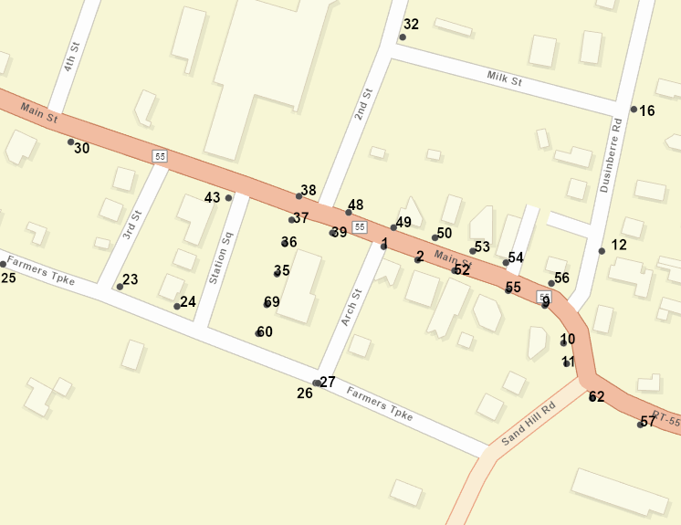
What we have accomplished
Created Streetlight Maps Example - Location Map
Other
ARC- GIS
Maps
include:
Wattage
  Functionality
  Type
Notes:
“The need for energy efficiency is serious, but so too is minimizing human risk from bad lighting, both due to glare and to circadian disruption. LED technology can optimize both when properly designed.”
(https://www.cnn.com/2016/06/21/health/led-streetlights-ama/index.html

Slide 11
What we have accomplished –
LED Outdoor Lighting Policy
Consulted with dark sky outdoor lighting professional familiar with calculating appropriate lumens, wattage, color, appearance, and shielding.
Created LED Streetlight guidelines compliant with the International Dark Sky Association (IDA)
Notes:
“The need for energy efficiency is serious, but so too is minimizing human risk from bad lighting, both due to glare and to circadian disruption. LED technology can optimize both when properly designed.”
(https://www.cnn.com/2016/06/21/health/led-streetlights-ama/index.html

Slide 12
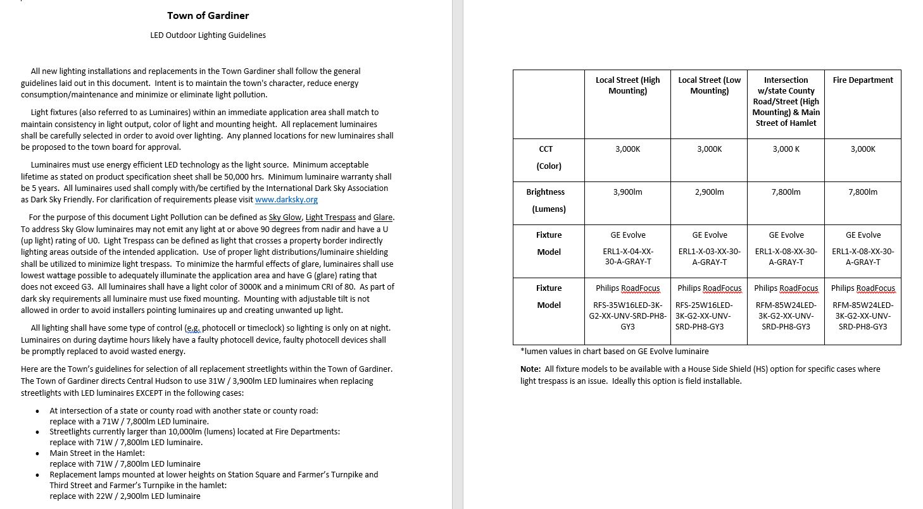
LED Outdoor Lighting Policy
Notes:
“The need for energy efficiency is serious, but so too is minimizing human risk from bad lighting, both due to glare and to circadian disruption. LED technology can optimize both when properly designed.”
(https://www.cnn.com/2016/06/21/health/led-streetlights-ama/index.html

Slide 13
LED Outdoor Lighting Policy
Intent of Lighting Policy
Maintain the character of town at night
Provide consistency of fixture types used
Avoid over lighting, wasted energy and light pollution
Notes:
“The need for energy efficiency is serious, but so too is minimizing human risk from bad lighting, both due to glare and to circadian disruption. LED technology can optimize both when properly designed.”
(https://www.cnn.com/2016/06/21/health/led-streetlights-ama/index.html

Slide 14
LED Outdoor Lighting Policy
Technical Requirements
LED only
Full Cutoff / No up-light
3000K warm light color
Long Life (10 years until L70/end of life)
Back-light shield option
Notes:
“The need for energy efficiency is serious, but so too is minimizing human risk from bad lighting, both due to glare and to circadian disruption. LED technology can optimize both when properly designed.”
(https://www.cnn.com/2016/06/21/health/led-streetlights-ama/index.html

Slide 15
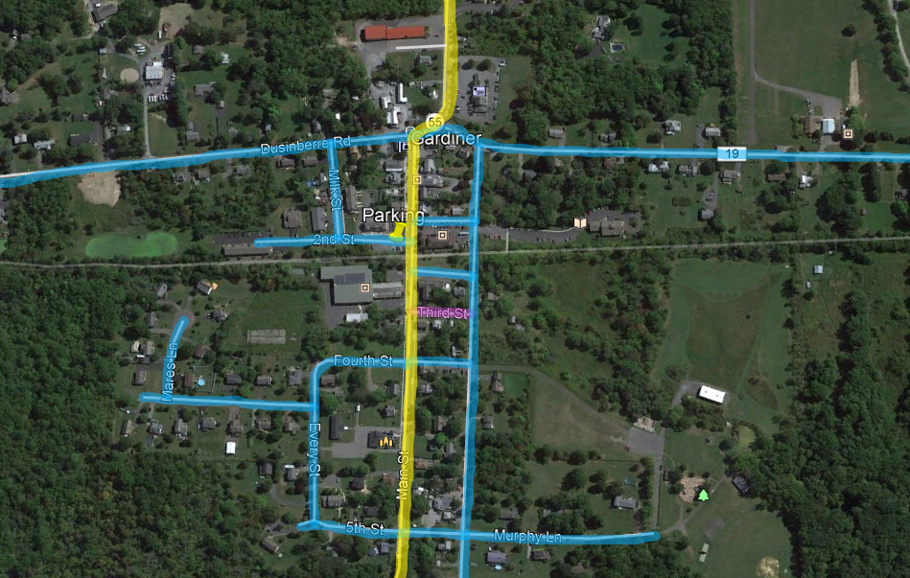
LED Outdoor Lighting Policy
= 3,900lm
= 2,900lm
= 7,800lm
Notes:
“The need for energy efficiency is serious, but so too is minimizing human risk from bad lighting, both due to glare and to circadian disruption. LED technology can optimize both when properly designed.”
(https://www.cnn.com/2016/06/21/health/led-streetlights-ama/index.html

Slide 16
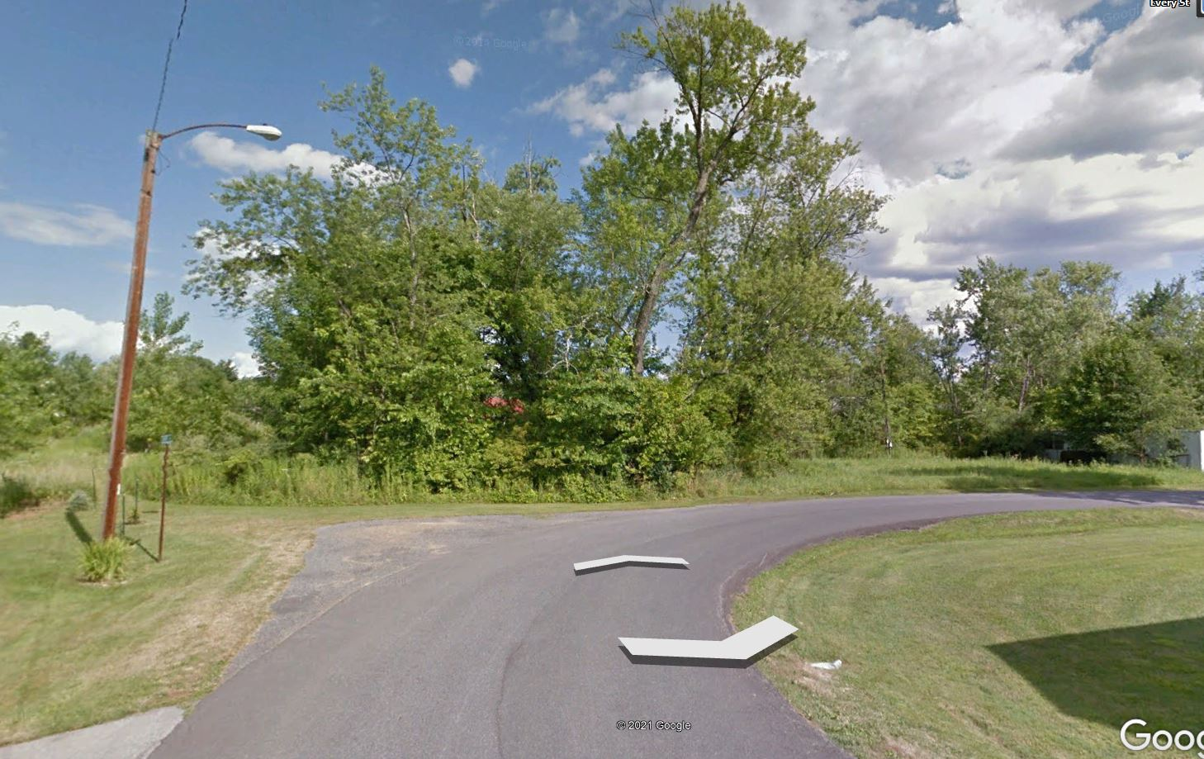
LED Outdoor Lighting Policy
Side Streets
Low Speed / Low Traffic
Medium Mounting Height
3,900lm / 31W
Notes:
“The need for energy efficiency is serious, but so too is minimizing human risk from bad lighting, both due to glare and to circadian disruption. LED technology can optimize both when properly designed.”
(https://www.cnn.com/2016/06/21/health/led-streetlights-ama/index.html

Slide 17
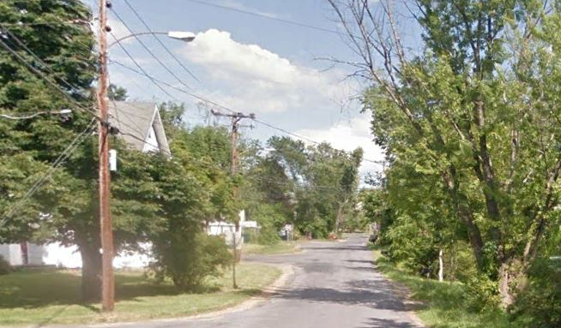
LED Outdoor Lighting Policy
Side Streets
Low Speed / Low Traffic
Low Mounting Height
2,900lm / 22W
Notes:
“The need for energy efficiency is serious, but so too is minimizing human risk from bad lighting, both due to glare and to circadian disruption. LED technology can optimize both when properly designed.”
(https://www.cnn.com/2016/06/21/health/led-streetlights-ama/index.html

Slide 18
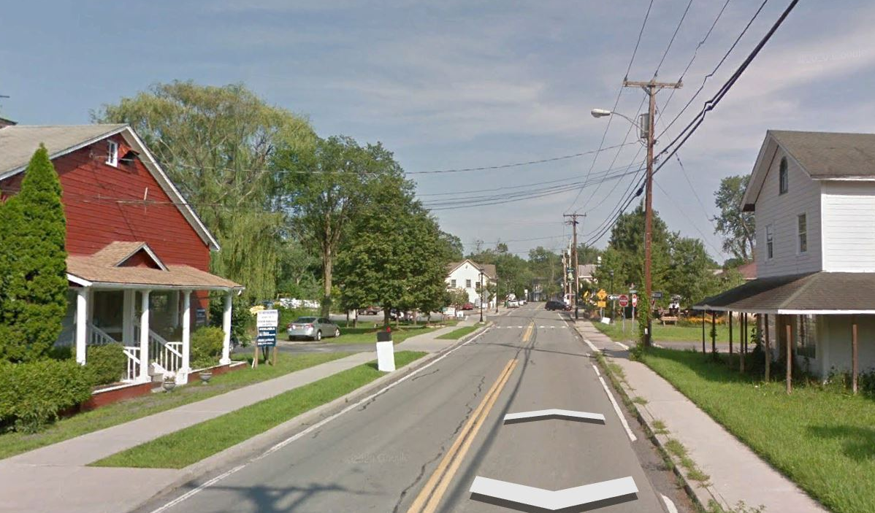
LED Outdoor Lighting Policy
Main Street
Medium Speed / High Traffic
High Mounting Height
7,800lm / 71W
Notes:
“The need for energy efficiency is serious, but so too is minimizing human risk from bad lighting, both due to glare and to circadian disruption. LED technology can optimize both when properly designed.”
(https://www.cnn.com/2016/06/21/health/led-streetlights-ama/index.html

Slide 19
LED Outdoor Lighting Policy
Streetlight Specifications
Application Type → | Local Street (High Mounting) | Local Street (Low Mounting) | Intersection w/state County Road/Street (High Mounting) & Main Street of Hamlet | Fire Department
Color (CCT) | 3,000K | 3,000K | 3,000K | 3,000K
Brightness (Lumens) | 3,900lm | 2,900lm | 7,800lm | 7,800lm
Brand (Model) | GE Evolve ERL1-X-04-XX-30-A-GRAY-T | GE Evolve ERL1-X-03-XX-30-A-GRAY-T | GE Evolve ERL1-X-08-XX-30-A-GRAY-T | GE Evolve ERL1-X-08-XX-30-A-GRAY-T
Brand (Model) | Philips RoadFocus RFS-35W16LED-3K-G2-XX-UNV-SRD-PH8-GY3 | Philips RoadFocus RFS-25W16LED-3K-G2-XX-UNV-SRD-PH8-GY3 | Philips RoadFocus RFM-85W24LED-3K-G2-XX-UNV-SRD-PH8-GY3 | Philips RoadFocus RFM-85W24LED-3K-G2-XX-UNV-SRD-PH8-GY3

Slide 20
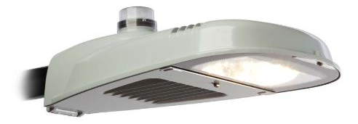
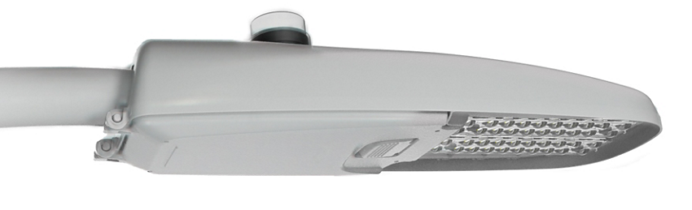
LED Outdoor Lighting Policy
Leasing vs. Owning
  Central Hudson – GE Evolve, LED Streetlight
  NYPA – Phillips RoadFocus, LED Streetlight
  *Comparable luminaires with only small
  technical differences.
(GE)
(Philips)
Notes:
“The need for energy efficiency is serious, but so too is minimizing human risk from bad lighting, both due to glare and to circadian disruption. LED technology can optimize both when properly designed.”
(https://www.cnn.com/2016/06/21/health/led-streetlights-ama/index.html

Slide 21
What we have asked Central Hudson (CH)
Requested suspension of CH fixing inoperative lamps until we provide them with specifications for LED conversion and give approval
Requested CH conduct an audit and provide the town with the cost for purchasing CH-owned cobrahead lamps
Notified CH that some LED lamps were installed at a tilt rather than flat and requested they be installed flat in compliance with IDA
Notes:
“The need for energy efficiency is serious, but so too is minimizing human risk from bad lighting, both due to glare and to circadian disruption. LED technology can optimize both when properly designed.”
(https://www.cnn.com/2016/06/21/health/led-streetlights-ama/index.html

Slide 22
On the Horizon
Central Hudson conducts their own energy/billing audit
Development of lighting policy specifications for outdoor decorative lamps
Addition of LED Outdoor Lighting Policy to Town’s Master Plan
Taskforce works to carefully preserve town’s streetlamp appearance while converting streetlamps to LEDs, which would include possibly eliminating and adding lamps
Solicit community feedback during this process including public safety officials
Notes:
“The need for energy efficiency is serious, but so too is minimizing human risk from bad lighting, both due to glare and to circadian disruption. LED technology can optimize both when properly designed.”
(https://www.cnn.com/2016/06/21/health/led-streetlights-ama/index.html

Slide 23
On the Horizon (cont’d)
Consider town maintenance of Cliff’s View Lane and Mare’s Lane Lamps
Explore ownership and LED conversion and maintenance options with NYPA
Decision making with regards to inoperative lamps
Notes:
“The need for energy efficiency is serious, but so too is minimizing human risk from bad lighting, both due to glare and to circadian disruption. LED technology can optimize both when properly designed.”
(https://www.cnn.com/2016/06/21/health/led-streetlights-ama/index.html

Slide 24
Requests of the Town Board
Addition of Outdoor LED Lighting Policy to Master Plan
Help obtaining information from Central Hudson
  We need cost to buy out CH-owned cobrahead lamps (LED and non-LED) for a NYPA proposal
  Facilitate communications with CH
Weigh options re LED conversion of inoperative lamps by Central Hudson vs. NYPA
Notes:
“The need for energy efficiency is serious, but so too is minimizing human risk from bad lighting, both due to glare and to circadian disruption. LED technology can optimize both when properly designed.”
(https://www.cnn.com/2016/06/21/health/led-streetlights-ama/index.html

